Slide 1
Lecture 6: Optimization of Discrete Models
Using mathematical tools to explore real-world problems.
Ref: Textbook Chapter 7

Slide 2
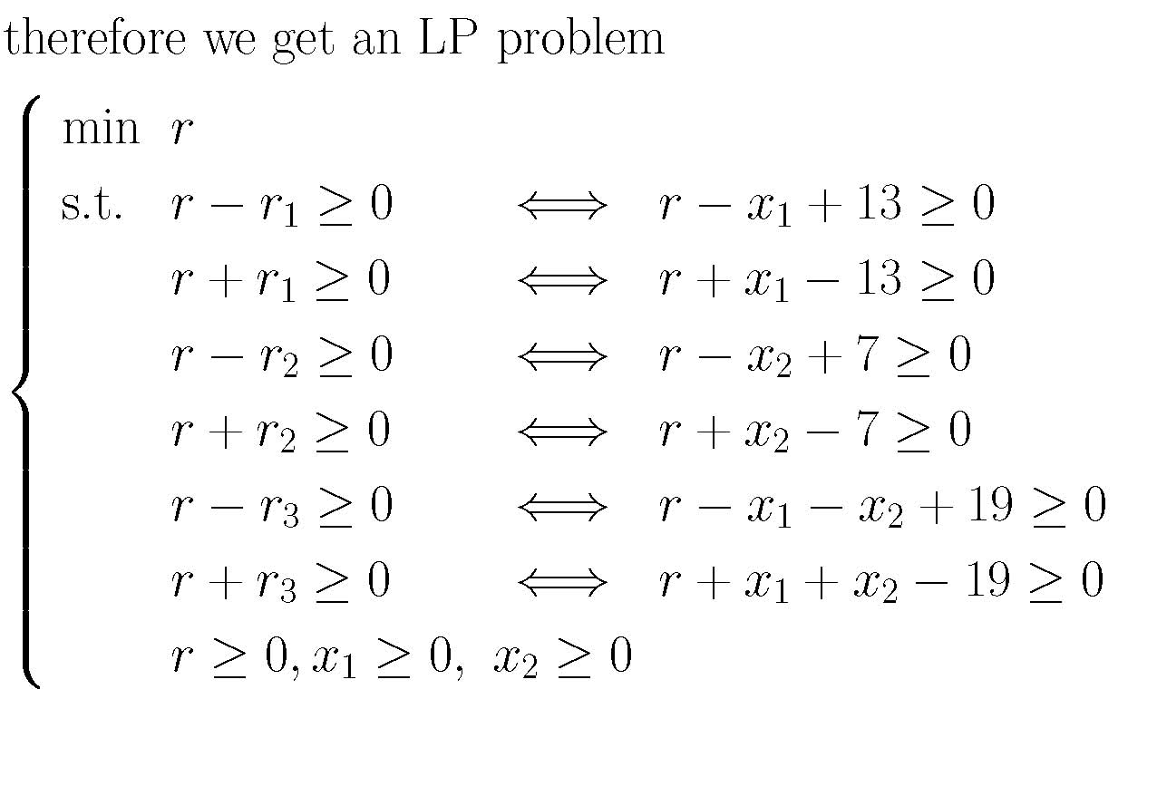
Recall: Chebyshev criterion: length measurement

Slide 3
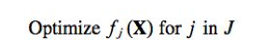
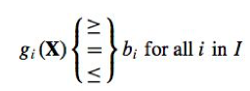
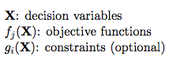
Basic model of optimization
Subject to

Slide 4
Basic steps for formulating the optimization model
1. Identify the decision variables: What decision needs to be made?
2. Formulate the objective function: How do these decisions affect the objective?
3. Formulate the constraint set: What constraints must be satisfied?

Slide 5
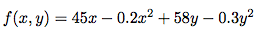
Example 1. Production Schedule (p.243)
Consider a carpenter who makes tables and bookcases. The revenues in dollars are estimated by
50x-0.2x² (x is the number of tables)
65y-0.3y² (y is the number of bookcases)
Further suppose the cost for a table and a bookcase is 5 and 7 dollars respectively. The profits are then estimated by

Slide 6
Example 1. Production Schedule (p.243)
Find values of x, y to maximize f(x,y) is an unconstrained optimization problem

Slide 7
Example 1. Production Schedule (p.243)
Now consider a slightly different scenario. The carpenter realizes a net unit profit of $25 per table and $30 per bookcase. He has up to 690 board-feet of lumber and 120 hours of labor per week.
Suppose it requires 20 board-feet of lumber and 5 hr to complete a table and 30 board-feet of lumber and 4 hr for a bookcase.
Further suppose he has signed a contract to make at least 4 tables and 2 bookcases per week.

Slide 8
Example 1. Production Schedule
Consider x₁ as the number of tables and x₂ as the number of bookcases. The optimization problem is
Maximize 25x₁ + 30x₂ (profit)
Subject to
20x₁+30x₂ ≤ 690 (lumber)
5x₁+4x₂ ≤ 120 (labor)
x₁≥4 (contract)
x₂≥2 (contract)
This is a constrained optimization problem.

Slide 9
Linear program
An optimization problem is a linear program if
There is only one unique objective function (opposite: multi-objective program)
Linear terms in objective and constraint functions; no terms in objective and constraint functions involve product of decision variables (opposite: non-linear program)
Constant coefficients of decision variables (opposite: dynamic program)

Slide 10
Integer program
In a linear program, if one or more decision variables are restricted to be integers, then the problem is also an integer program or mixed-integer program
Example:
Number of objects
Binary state (0 or 1): on/off, yes/no

Slide 11
Example 2: Space shuttle cargo (p. 246)
There are various items to be taken on a space shuttle. Unfortunately, there are restrictions on the allowable weight and volume capacities. Suppose there are m different items, each given some numerical value c_{j} and having weight w_{j} and volume v_{j}. Suppose the goal is to maximize the value of the items that are to be taken without exceeding the weight limitation W or the volume limitation V.

Slide 12
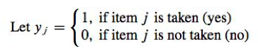
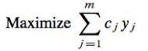
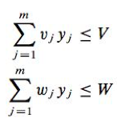
Example 2: Space shuttle cargo (p. 246)
Problem formulation
Objective function
subject to constraints

Slide 13
Multi-objective program
Problems with more than one objective function are called multi-objective or multi-goal programs.
Common applications include finance and radio resource management

Slide 14
Example 3: Investment decision
An investor is considering investments in savings at 7%, municipal bonds at 9%, and stocks averaging at 14%. She has listed the following goals for her portfolio:
A yearly return of at least $5000.
An investment of at least $10,000 in stocks.
The investment in stocks should not exceed the combined total in bonds and savings.
A liquid savings account between $5000 and $15,000.
The total investment must not exceed $40,000.

Slide 15
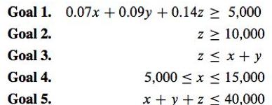
Example 3: Investment decision
Problem formulation
Not all goals can be satisfied simultaneously.

Slide 16
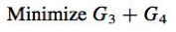
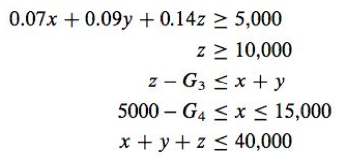
Example 3: Investment decision
Suppose the investor is willing to compromise on Goals 3 and 4. However, she wants to find a solution that minimizes the amounts by which these two goals fail to be met.
The new formulation would be
Subject to

Slide 17
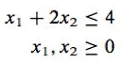
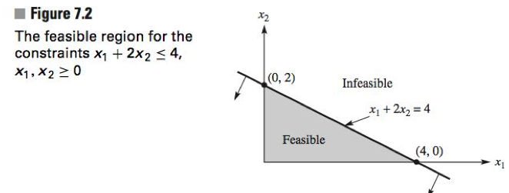
Geometric solutions for linear programs
Consider the following constraints
Plot the feasible region geometrically

Slide 18
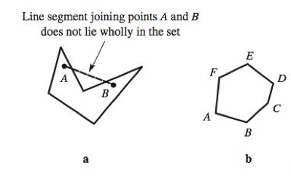
Convex set
A set is convex if for every pair of points in the set, the line segment joining them lies wholly in the set.
Not convex
Convex

Slide 19
Convex set
An extreme point (corner point) of a convex set is any boundary point in the convex set that is the unique intersection point of two of the (straight-line) boundary segments.
If an optimal solution to the linear program exists, it must be taken on at one or more of the extreme points.

Slide 20
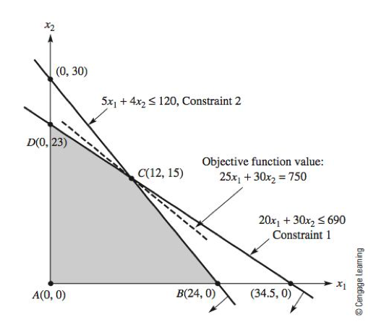
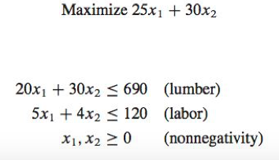
Carpenter case revisited (ignore contract constraints)
Extreme points

Slide 21
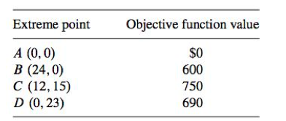
The values of the objective function at each extreme point are
Thus, the carpenter should make 12 tables and 15 bookcases each week to earn a maximum weekly profit of $750.

Slide 22
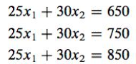
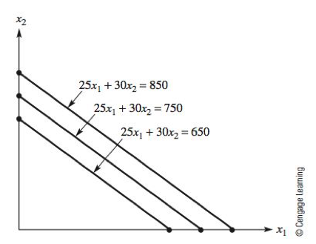
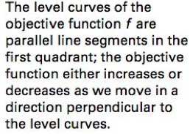
If we plot for the objective function 25x₁+30x₂
The objective function has constant values along these line segments (level curves)

Slide 23
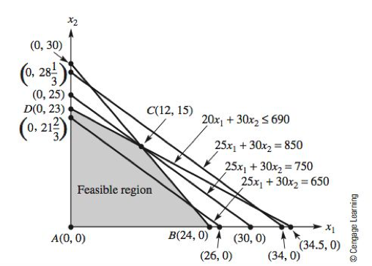
Overlay the lines with the feasible region
The level curve with value 750 is the one that intersects the feasible region exactly once at the extreme point C.

Slide 24
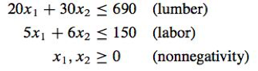
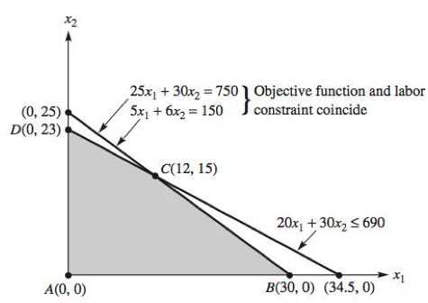
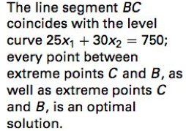
If we slightly modify the constraint functions to

Slide 25
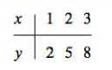
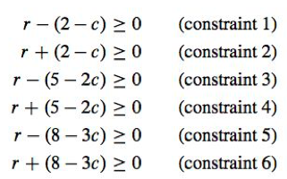
Example 4: data fitting (p.258)
Use the model y = cx to fit the data set by Chebyshev criterion
Formulate the constraints

Slide 26
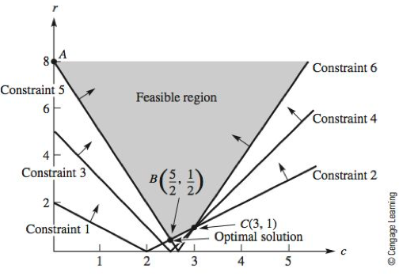
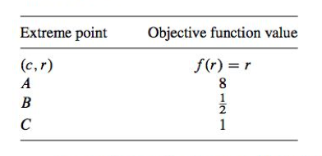

Slide 27
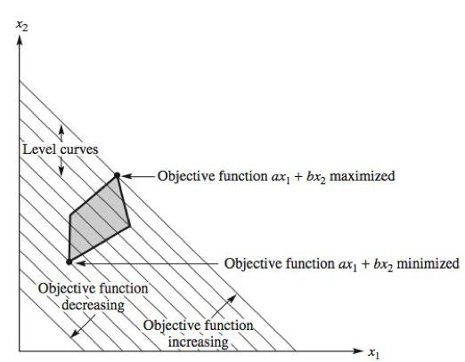
Summary: A linear function assumes its maximum and minimum values on a nonempty and bounded convex set at an extreme point.

Slide 28
Exercise
Consider a company that carves wooden soldiers. The company specializes in two main types: Confederate and Union soldiers. The profit for each is $28 and $30, respectively. It requires 2 units of lumber, 4 hr of carpentry, and 2 hr of finishing to complete a Confederate soldier. It requires 3 units of lumber, 3.5 hr of carpentry, and 3 hr of finishing to complete a Union soldier. Each week the company has 100 units of lumber delivered. There are 120 hr of carpenter machine time available and 90 hr of finishing time available. Determine the number of each wooden soldier to produce to maximize weekly profits.

Slide 29
Algebraic solutions of linear programs
Recall the steps in finding geometric solution:
1. Find all intersection points of the constraints.
2. Determine which intersection points, if any, are feasible to obtain the extreme points.
3. Evaluate the objective function at each extreme point.
4. Choose the extreme point(s) with the largest (or smallest) value for the objective function.
How to find extreme points and determine whether they are feasible?

Slide 30
(0,30) and (34.5,0) are infeasible intersection points!!

Slide 31
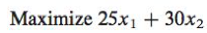
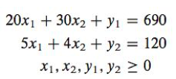
Add “slack” non-negative variables y₁ and y₂ to the constraints
Subject to
Subject to

Slide 32
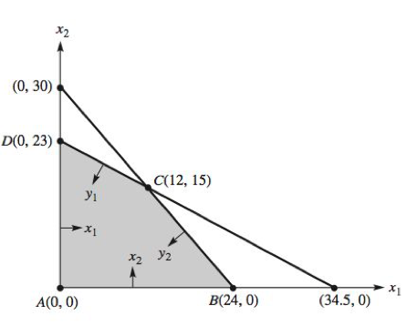
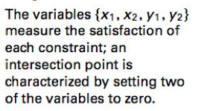
The geometric meaning for each x and y is the deviation from the level curve corresponding to each constraint.
If x_{i} or y_{i} ≥ 0, the constraint is satisfied. Otherwise the constraint is violated

Slide 33
Setting x₁= x₂ = 0, obtain y₁ = 690, y₂ = 120 (feasible solution, objective function = 0)
Setting x₁= y₁ = 0, obtain x₂ = 23, y₂ = 28 (feasible solution, objective function = 690)
Setting x₁= y₂ = 0, obtain x₂ = 30, y₁ = -210 (infeasible solution)
Setting y₁= x₂ = 0, obtain x₁ = 34.5, y₂ = -21.5 (infeasible solution)
Setting y₁= y₂ = 0, obtain x₁ = 12, x₂ = 15 (feasible solution, objective function = 750)
Setting x₂= y₂ = 0, obtain x₁ = 24, y₂ = 210 (feasible solution, objective function = 600)

Slide 34
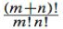
Computational complexity
Suppose we have a linear program with m nonnegative decision variables and n constraints (in the form of ≤)
Convert each inequality to an equation by adding a non-negative ‘‘slack’’ variable y_{i} to the ith constraint. We now have a total of m + n nonnegative variables.
To determine an intersection point, choose m of the variables (because we have m decision variables) and set them to zero. There are possible choices to consider.

Slide 35
The Simplex method
In order to improve computational efficiency in finding optimal solutions in a linear program
Incorporates both optimality and feasibility tests
An optimality test shows whether or not an intersection point corresponds to a value of the objective function better than the best value found so far.
A feasibility test determines whether the proposed intersection point is feasible.

Slide 36
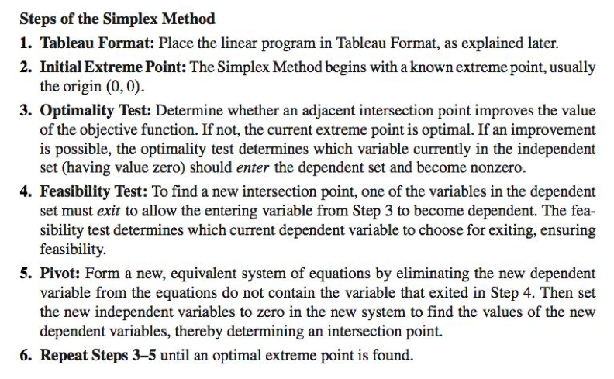

Slide 37
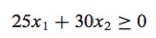
Carpenter example revisited again
We begin with the origin (0,0), which is obviously a feasible extreme point, with the value of the objective function equal to 0.
As we want to improve the value of the objective function, we add another constraint
Subject to

Slide 38
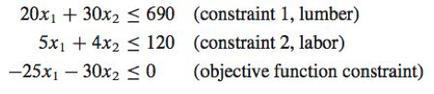
For consistency, by using the Simplex method, we assume that
The objective function is always to be maximized
All the constraints are less than or equal to inequalities
All variables are nonnegative
Therefore the constraint set is transformed to

Slide 39
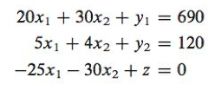
Next, we convert each inequality to an equality by adding a nonnegative slack variable y_{i} (or z), which gives the augmented constraint set/tableau format
Note that the value of z gives the value of the objective function
Change x₁ or x₂ to increase z (which one and how much?)

Slide 40
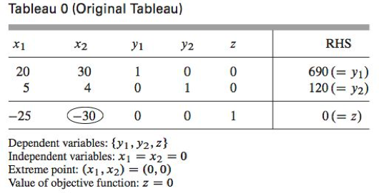
The original tableau is
Optimality test: Negative coefficients indicate that the corresponding variable could improve the current objective function value
Select the variable to enter the dependent set is to select that variable with the largest (in absolute value) negative coefficient in the objective function row

Slide 41
We have chosen x₂ as the entering variable (change from independent to dependent variable). It must replace either y₁ or y₂ as a dependent variable.
Note that z always remains as a dependent variable – we need to calculate it based on other variables!

Slide 42
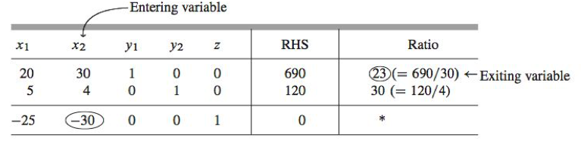
Divide the RHS values by the components for the entering variable in each inequality
Feasibility test: From the subset of ratios that are positive (both in this case), the variable corresponding to the minimum ratio is chosen for replacement (Min. positive ratio rule)
The ratios represent the value the entering variable would obtain if the corresponding exiting variable were assigned the value 0

Slide 43
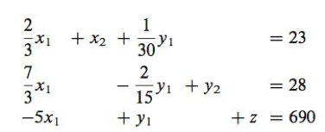
Pivoting: Eliminate the entering variable (x₂) from all the equations that do not contain the exiting variable (y₁).
Set the new set of independent variables x₁ and y₁ to 0, we obtain an equivalent system

Slide 44
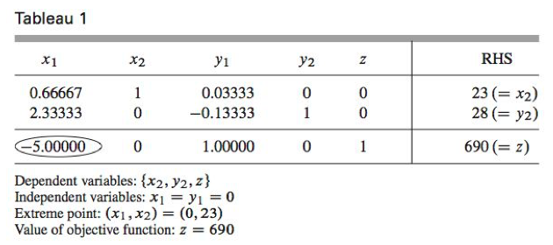
From the equivalent system, obtain a new tableau.
Note that z has been improved. Now repeat the process as there is still a negative coefficient in the bottom row.

Slide 45
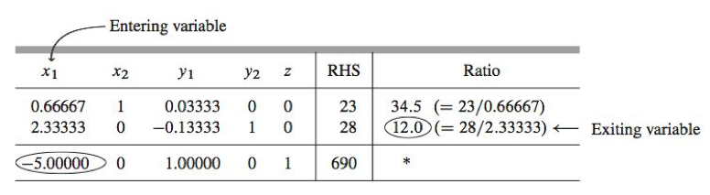
x₁ is chosen as the entering variable and y₂ as the exiting variable.
We repeat pivoting by setting y₁ and y₂ (the set of independent variables) to 0

Slide 46
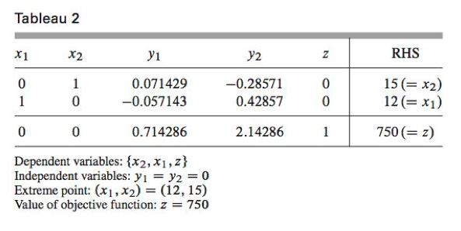
No negative coefficients in Tableau 2, indicating that z cannot be further increased.
Note that we only need to compute 2 of the possible 6 intersection points by using the Simplex method.

Slide 47
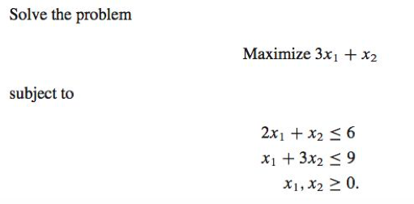
Another example of Simplex method

Slide 48
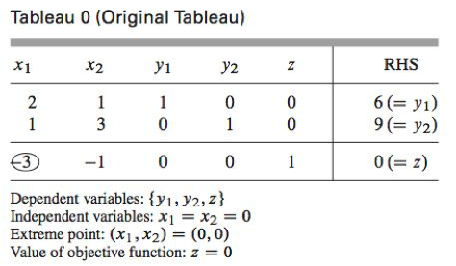
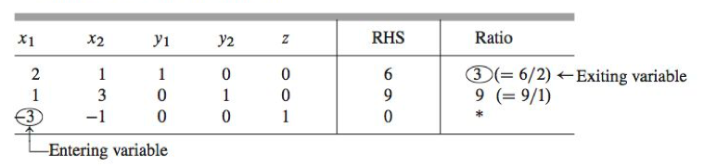

Slide 49
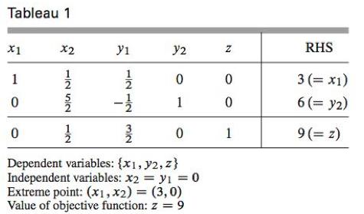
No negative coefficients in the bottom row, we have found the optimal solution.

Slide 50
Remarks on Simplex method
We have assumed that the origin is a feasible extreme point. If it is not, then some extreme point must be found before the Simplex Method can be used as presented. We have also assumed that the linear program is not degenerate in the sense that no more than two constraints intersect at the same point. These restrictions and other topics are studied in more advanced treatments of linear programming.

Slide 51
Exercise
Use the simplex method to solve the wooden solders example.

Slide 52
Sensitivity analysis
A mathematical model typically approximates a problem under study.
The coefficients in the objective function of a linear program may only be estimates.
The amount of the resources constraining production made available may vary.
Therefore, in addition to solving a linear program, we would like to know how sensitive the optimal solution is to changes in the various constants used to formulate the program.

Slide 53
Carpenter case revisited again
Suppose the profit per table is a variable c₁, the objective function becomes
This is a line with slope -c₁/30 in the x₁x₂-plane
Intuitively, if c₁ is large enough, then we should spend all resources making tables; if c₁ is small enough, then we should spend all resources making bookcases

Slide 54
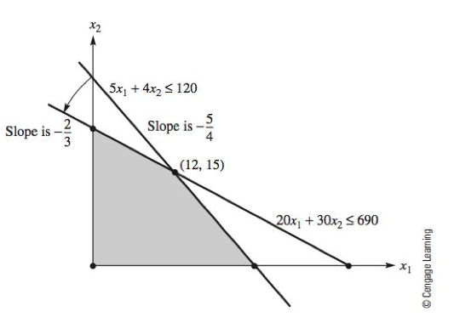
If the slope of the objective function is between -5/4 and -2/3, the extreme point (12,15) remains optimal.
If the slope of the objective function is smaller than -5/4, the extreme point (24,0) is optimal.
If the slope of the objective function is larger than -2/3, the extreme point (0,23) is optimal.

Slide 55
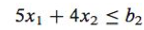

Now we change the amount of available resources. Say we set the number of working hours (labor) as variable b_{2.} The labor constraint becomes

Slide 56

If b₂ increases beyond 5 x 34.5 = 172.5, the optimal solution remains at the extreme point (34.5, 0).

Slide 57

One goal is to determine how much the objective function value changes as b₂ increases by 1 unit.
If b₂ increases by 1 unit from 120 to 121, then the new extreme point represented by the intersection of the constraints
would be A’(12.429, 14.714).
The objective function value is 752.14
Due to linearity, the net effect as b₂ increases by 1 unit is to increase the objective function by 2.14 units.

Slide 58
In terms of the objective function, an additional unit of labor is worth 2.14 units. If management can procure a unit of labor for less than 2.14 it would be profitable to do so.
Conversely, if management can sell labor for more than 2.14 (which is valid until labor is reduced to 92 units (why?)) it should also consider doing that.
Sensitivity analysis gives the value of a unit of resource in terms of the value of the objective function at the optimal extreme point, which is a marginal value.

